Slide 1
DATA STRUCTURES
UNIT-1
Prepared By:
NITIKA KAPOOR
AP,CSE DEPARTMENT

Slide 2
Learning Outcomes:
Understand the properties of various data structures.
Identify the strengths and weaknesses of different data structures.
Various Complexity notations of an algorithm.
Logic behind various Searching and sorting Algorithms.

Slide 3
Introduction: Concept of data and information, Introduction to Data Structures, Types of data structure: Linear and non-linear data structures, operations on Data Structures, Algorithm complexity, Time-space trade off, asymptotic notations. [4]
Arrays: Basic terminology, Linear arrays and their representation, Traversing Linear Array, Insertion & Deletion in arrays, searching – linear search, binary search, sorting – insertion sort , selection sort , bubble sort , merging arrays & merge sort , complexity analysis of each algorithm, Multi-dimensional arrays and their representation, Pointers; Pointer Arrays, Records; Record structure, representation of records in Memory, Parallel Arrays, sparse matrices and their storage. [12]

Slide 4
Data Type and Data Structure
Data type
Set of possible values for variables
Operations on those values
Ex : int, float, char ……….
Data Structure
A data structure is an arrangement of data in a computer's memory or even disk storage.
The logical and mathematical model of a particular organization of data is called a data structure.
A data structure is a particular way of storing and organizing data in a computer so that it can be used efficiently.

Slide 5
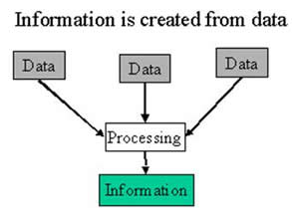
Data & Information
Data - Data usually refers to raw data, or unprocessed data. It is the basic form of data, data that hasn’t been analyzed or processed in any manner.
Information - Once the data is analyzed, it is considered as information.

Slide 6
Linear and Non-Linear Data structures
Linear data structure: A data structure is said to be linear if the elements form a sequence, for example Array, Linked list, stack ,queue etc.
Non-Linear data structure: Elements in a nonlinear data structure do not form a sequence, for example Tree, graph.

Slide 7
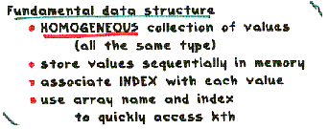
Array
Linear array (One dimensional array) : A list of finite number n of similar data elements referenced respectively by a set of n consecutive numbers, usually 1, 2, 3,…..n. That is a specific element is accessed by an index.
Let, Array name is A then the elements of A is : a₁,a₂….. A_{n} or by the bracket notation A[1], A[2], A[3],…………., A[n].The number k in A[k] is called a subscript and A[k] is called a subscripted variable.
element.

Slide 8
Example
A linear array STUDENT consisting of the name of six students
STUDENT
1 2 3 4 5 6 | Atul Kumar
 | Sumona
 | Richa
 | Kamaljeet
 | Avleen
 | Jatin
Here, STUDENT[4] denote Kamaljeet

Slide 9
Array (con…)
Linear arrays are called one dimensional arrays because each element in such an array is referenced by one subscript.
(Two dimensional array) : Two dimensional array is a collection of similar data elements where each element is referenced by two subscripts.
Such arrays are called matrices in mathematics.
Multidimensional arrays are defined analogously
MATRICES
1 2 3 4
1
2
1 | 2 | 3 | 4
5 | 6 | 7 | 8
9 | 10 | 11 | 12
13 | 14 | 15 | 16
Here, MATRICES[3,3]=11
3
4

Slide 10
Array (con…)
Array Data Structure
It can hold multiple values of a single type.
Elements are referenced by the array name and an ordinal index.
Each element is a value
Indexing begins at zero in C.
The array forms a contiguous list in memory.
The name of the array holds the address of the first array element.
We specify the array size at compile time, often with a named constant or at run time using calloc(), malloc() & realloc() in C and new in C++.
Arrays – Advantage & disadvantage
Fast element access.
Impossible to resize. Many applications require resizing so linked list was introduced.

Slide 11
Linked lists
A linked list, or one way list, is a linear collection of data elements, called nodes, where the linear order is given by means of pointers.
Dynamically allocate space for each element as needed.
Node
Data
Next
In linked list –
Each node of the list contains the data item
and a pointer to the next node.
2. There is a pointer to the list Start which contains address of
first node.
Initially NULL
Start

Slide 12
Linked lists (con…)
Start
node
node
Data
Next
Data
Linked list with 2 nodes

Slide 13
Linked lists (con…)
INFO
LINK
1
2
3
4
5
6
7
8
A
M
G
N
O
5
2
7
4
0
START
START=3, INFO[3]=M
LINK[3]=2, INFO[2]=A
LINK[2]=5, INFO[5]=N
LINK[5]=4, INFO[4]=G
LINK[4]=7, INFO[7]=O
LINK[7]=0, NULL value, So the list has ended
3

Slide 14
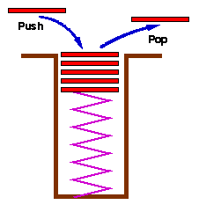
Stacks
Stacks are a special form of data structures where insertion & deletion of items takes place at one end called TOP of the stack.
Two methods
- add item to the top of the stack
- remove an item from the top of the stack
Like a plate stacker
Follows LIFO (Last in First Out) principle.

Slide 15
Queues
Like a stack, a queue is also a list. However, with a queue, insertion is done at one end, while deletion is performed at the other end.
-- The insertion end is called rear
-- The deletion end is called front
Remove
Insert
front
rear

Slide 16
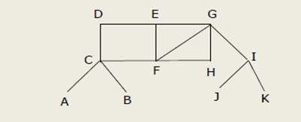
Graph
A graph data structure consists of vertices and edges.
For Ex, A network of computers is represented by a graph.

Slide 17
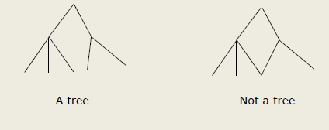
Tree
A tree is a graph that does not contain any cycles.

Slide 18
Data structure operations
The data appearing in our data structure is processed by means of certain operations. In fact, the particular data structure that one chooses for a given situation depends largely on the frequency with which specific operations are performed. The following four operations play a major role: Traversing Accessing each record exactly once so that certain items in the record may be processed. (This accessing or processing is sometimes called 'visiting" the records.) Searching Finding the location of the record with a given key value, or finding the locations of all records, which satisfy one or more conditions. Inserting Adding new records to the structure. Deleting Removing a record from the structure.

Slide 19
Data structure operations (Con..)
The following two operations, which are used in special situations, will also be considered:
Sorting:
Arranging the records in some logical order
Merging:
Combining the records in two different sorted files into a single sorted file.

Slide 20
Algorithm Complexity
Space Complexity - The space complexity of an algorithm ,hence program ,is the amount of memory it needs to run to completion. Some of the reasons for studying space complexity are:
If the program is to run on multi-user system, it may be required to specify the amount of memory to be allocated to the program.
We may be interested to know in advance that whether sufficient memory is available to run the program.
can be used to estimate the size of the largest problem that a program can solve.

Slide 21
Algorithm Complexity(contd..)
2. Time Complexity – The time complexity of an algorithm is the amount of time it needs to run to completion. Some of the reasons for studying time complexity are:
We may be interested to know in advance that whether the program will provide a satisfactory real-time response. For ex, an interactive program such as editor, must provide such response. If it takes even a few seconds to move cursor one page up or down, it will not be acceptable to the user.

Slide 22
Algorithm Complexity(contd..)
Time-space tradeoff– The best algorithm , hence best program , to solve a given problem is one that requires less space in memory and takes less time to complete its execution. But in practice, it is not always possible to achieve both of these objectives.
there may be more than one approach to solve a same problem. One such approach may require more space but takes less time to complete its execution while the other approach requires less space but takes more time to complete its execution. Thus, we may have to sacrifice one at the cost of the other.

Slide 23
Algorithm Complexity(contd..)
1. Best case Complexity – The term best-case performance is used in computer science to describe an algorithm's behaviour under optimal conditions. For example, the best case for a simple linear search on a list occurs when the desired element is the first element of the list.
2. Average Case Complexity– The average-case complexity of an algorithm is the amount of some computational resource used by the algorithm, averaged over all possible inputs
3. Worst Case Complexity– The worst-case measures the resources (e.g. running time, memory) an algorithm requires in the worst-case. It gives an upper bound on the resources required by the algorithm.

Slide 24
Asymptotic Notations
1) Big oh ‘O’ Notation: Big O is the formal method of expressing the upper bound of an algorithm running time. It is a measure of longest amount of time it could possibly take for the algorithm to complete.
For functions, f(n)& g(n) of g(n) if there exists an integer n₀ and a constant c>0 such that for all integers n>n₀, f(n)≤c.g(n), then f(n) is big O of g(n). This is denoted as f(n)=O(g(n)).

Slide 25
Big oh ‘O’ Notation(contd..)
Example of Big O notations:
O(1)→ O(1) describes an algorithm that will always execute in the same time regardless of the size of the input data set.
Example1: To find that the string is NULL or not.
int isfirstelementnull(char string[8])
{
if(string[0]==NULL)
cout<<“\n String is NULL”;
else
cout<<“\n String is NOT NULL”;
}
void main()
{
char str[8]=“hello”;
cout<<isfirstelementnull(str);
getch();
}

Slide 26
Big oh ‘O’ Notation(contd..)
Example 2:
O(N)→ count no. of occurrences of an integer.
void main()
{
int arr[8]={2,3,8,9,6,5,7,1}, element, i,count=0;
cout<<“Enter element u want to search:”;
cin>>element;
for(i=0;i<8;i++)
{
if(arr[i]==element)
count++;
}
cout<<“Count of element is:”<<count;
getch();
}

Slide 27
Big oh ‘O’ Notation(contd..)
Example 3:
O(n²) → Finding duplicates in string. It takes a list of n items and compares every item to every other item.
int containsduplicate(char string[8])
{
for(int i=0;i<strlen(string)-1;i++)
{
for(j=0;j<strlen(string)-1;j++)
{
if(i==j)
continue;// don’t compare with self
if(string[i]==string[j])
return 1;
}
}
}

Slide 28
Example:
Let f(n)=7n+8 and g(n)=n. Is f(n)=O(g(n))?
for 7n+8=O(n), we have to find c and n₀ such that for all integers n> n₀ , f(n)≤c.g(n)
7n+8 ≤c.n
Let n=3 and c=3
7×3+8≤3×3
21+8 ≤9
29 ≤9 (not true). Increase the value of n or c
Let n=4 and c=4
7×4+8≤4×4
28+8 ≤16
36 ≤16 (not true). Increase the value of n or c
Let n=6 and c=6
7×6+8≤6×6
42+8 ≤36
50 ≤36 (not true). Increase the value of n or c
Let n=8 and c=8
7×8+8≤8×8
56+8 ≤64
64 ≤64 (true). Increase the value of n or c
Let n=9 and c=9
7×9+8≤9×9
63+8 ≤81
71≤81 (true). Increase the value of n or c
Let n=10 and c=10
7×10+8≤10×10
70+8≤100
78≤100 (true). Increase the value of n or c

Slide 29
Let n=12 and c=12
7×12+8≤12×12
84+8≤144
92≤100 (true). Increase the value of n or c
Let n=14 and c=14
7×14+8≤14×14
98+8≤196
106≤196 (true). Increase the value of n or c
Running time
Visually, this says
that the f(n) curve
must eventually fit
under the c.g(n) curve.

Slide 30
Asymptotic Notations: Big Omega ‘Ω’ Notation
2) Big Omega (Ω)Notation: It describes the best that can happen for a given data size.
For functions, f(n)& g(n) if there exists an integer n₀ and a constant c>0 such that for all integers n>n₀, f(n)≥c.g(n), then f(n) is omega of g(n). This is denoted as f(n)=(Ω g(n)).
Big Omega(Ω) is opposite to Big Oh(O) and specifies an lower bound instead of upper bound.

Slide 31
Example:
Let f(n)=2n³ +4n²+5n+10 and g(n)= n² +50n+4. Is f(n)=Ω(g(n))?
for 7n+8=O(n), we have to find c and n₀ such that for all integers n> n₀ , f(n)≥c.g(n)
2n³ +4n²+5n+10 ≥ c.n² +50n+4
Let n=2 and c=2
2×2³+4×2²+5×2+10 ≥ 2× 2² +50 ×2+4
16+16+10+10 ≥ 8+100+4
52 ≥ 12 (not true). Increase the value of n or c
Let n=3 and c=3
2×3³+4×3²+5×3+10 ≥ 3× 3² +50 ×3+4
54+36+25 ≥ 27+150+4
115 ≥ 181 (not true). Increase the value of n or c
Let n=4 and c=4
2×4³+4×4²+5×4+10 ≥ 4× 4² +50 ×4+4
128+64+30 ≥ 64+200+4
222≥ 268 (not true). Increase the value of n or c
Let n=5 and c=5
2×5³+4×5²+5×5+10 ≥ 5× 5² +50 ×5+4
250+100+35 ≥ 125+250+4
385≥ 379 (true). Increase the value of n or c
Let n=6 and c=6
2×6³+4×6²+5×6+10 ≥ 6× 6² +50 ×6+4
432+144+40 ≥ 216+300+4
616≥ 520 (true). Increase the value of n or c

Slide 33
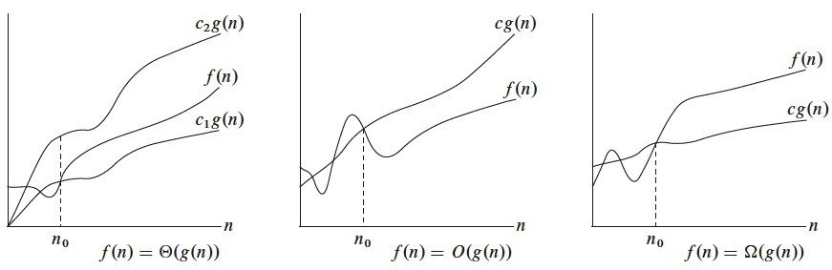
Theta ‘Ө’ Notation
In Theta notation, f(n) is bounded from the top and bottom by the same function g(n).
For functions, f(n)& g(n), f(n) is theta of g(n) if and only if f(n)=O(g(n)) and f(n)=Ω(g(n)). This is denoted as f(n)=(Ө g(n)).

Slide 34
Various complexities of algorithms
Constant: O(1)→ constant number of operations, not depending on the input data size,
e.g. n=10000→ 1 operation.
Logarithmic: O(log n)→ No. of operations proportional of log n where n is the size of input data,
e.g. n=1000→10operations.
Linear: O(n)→no. of operations proportional to the input data size,
e.g. n=10000→ 10000operations.
Quadratic: O(n²)→No. of operations proportional to the square of the size of the input data.
e.g. n=500→250000 operations
Cubic: O(n³)→ no. of operations proportional to the cube of the size of the input data,
e.g. n=10→ 1000 operations
Exponential: exponential no. of operations, fast growing,
e.g. n=20→ 1048576 operations.

Slide 35
Linear Arrays
A linear array is a list of finite number n of homogeneous data elements(i.e. data elements of same type)
The elements of the array are referenced respectively by an index set
The elements of the array are stored respectively in successive memory locations.
Let, Array name is A then the elements of A is : a1,a2….. an
Or by the bracket notation A[1], A[2], A[3],…………., A[n]
1 2 3 4 5 6 | 247
 | 56
 | 429
 | 135
 | 87
 | 156
DATA[1] = 247
DATA[2] = 56
DATA[3] = 429
DATA[4] = 135
DATA[5] = 87
DATA[6] = 156

Slide 36
Representation of linear array in memory
Let LA be a linear array in the memory of the computer. The memory of the computer is a sequence of addressed locations.
LA
1000 1001 1002 1003 1004 1005
The computer does not need to keep track of the address of every element of LA, but needs to keep track only of the first element of LA, denoted by
Base(LA)
called the base address of LA. Using this address Base(LA), the computer calculates the address of any element of LA by the following formula :
LOC(LA[k]) = Base(LA) + w(K – lower bound)
Where w is the number of words per memory cell for the array LA
Fig : Computer memory

Slide 37
Representation of linear array in memory
200 201 202 203 204 205 206 207 208 209 210 211 212
INDEX
Example :
An automobile company uses an array AUTO to record the number of auto mobile sold each year from 1932 through 1984. Suppose AUTO appears in memory as pictured in fig A . That is Base(AUTO) = 200, and w = 4 words per memory cell for AUTO. Then,
LOC(AUTO[1932]) = 200, LOC(AUTO[1933]) =204
LOC(AUTO[1934]) = 208
the address of the array element for the year K = 1965 can be obtained by using :
LOC(AUTO[1965]) = Base(AUTO) + w(1965 – lower bound)
=200+4(1965-1932)=332
AUTO[1932]
AUTO[1933]
AUTO[1934]

Slide 38
Representation of linear array in memory(contd.)
200 | 202 | 204 | 206 | 208 | 210 | 212 | 214 | 216 | 218 | 220 | 222 | 224 | 226 | 228 | 230
0 | 1 | 2 | 3 | 4 | 5 | 6 | 7 | 8 | 9 | 10 | 11 | 12 | 13 | 14 | 15
Example:
LOC(LA[6])=200+2(6-0) = 200+12 = 212
LOC(LA[9])=200+2(9-0) = 200+18 = 218
LOC(LA[15])=200+2(15-0) = 200+30 = 230

Slide 39
Traversing linear arrays
Print the contents of each element of DATA or Count the number of elements of DATA with a given property. This can be accomplished by traversing DATA, That is, by accessing and processing (visiting) each element of DATA exactly once.
Algorithm: Given DATA is a linear array with lower bound LB and upper bound UB . This algorithm traverses DATA applying an operation PROCESS to each element of DATA.
Set K : = LB.
Repeat steps 3 and 4 while K<=UB:
Apply PROCESS to DATA[k]
Set K : = K+1.
Exit.

Slide 40
Traversing linear arrays
Example :
An automobile company uses an array AUTO to record the number of auto mobile sold each year from 1932 through 1984.
a) Find the number NUM of years during which more than 300 automobiles were sold.
b) Print each year and the number of automobiles sold in that year
Set NUM : = 0.
Repeat for K = 1932 to 1984:
if AUTO[K]> 300, then : set NUM : = NUM+1
Exit.
Repeat for K = 1932 to 1984:
Write : K, AUTO[K]
Exit.

Slide 41
Inserting and Deleting
Inserting refers to the operation of adding another element to the Array
Inserting an element somewhere in the middle of the array require that each subsequent element be moved downward to new locations to accommodate the new element and keep the order of the other elements.
Deleting refers to the operation of removing one element from the Array
Deleting an element somewhere in the middle of the array require that each subsequent element be moved one location upward in order to “fill up” the array. Fig shows Milanjit Inserted, Sumona deleted.
STUDENT
STUDENT
STUDENT
1 2 3 4 5 6 | Amit Saraswat
 | Sumona
 | Milanjit
 | Sahil
 | Tammana
1 2 3 4 5 6 | Amit Saraswat
 | Sumona
 | Sahil
 | Tammana
1 2 3 4 5 6 | Amit Saraswat
 | Milanjit
 | Sahil
 | Tammana

Slide 42
Insertion in an array
INSERTING AN ELEMENT INTO AN ARRAY:
Insert (LA, N, K, ITEM)
Here LA is linear array with N elements and K(position) is a positive integer such that K<=N.This algorithm inserts an element ITEM into the Kth position in LA.
ALGORITHM
Step 1. [Initialize counter] Set J:=N
Step 2. Repeat Steps 3 and 4 while J>=K
Step 3. [Move Jth element downward] Set LA [J+1]: =LA [J]
Step 4. [Decrease counter] Set J:=J-1
[End of step 2 loop]
Step 5 [Insert element] Set LA [K]: =ITEM
Step 6. [Reset N] Set N:=N+1
Step 7. Exit

Slide 43
Deletion from an array
DELETING AN ELEMENT FROM A LINEAR ARRAY
Delete (LA, N, K, ITEM)
Here LA is a linear array with N elements and k is a positive integer such that K<=N. This algorithm deletes the Kth element from LA.
ALGORITHM
Step 1. Set ITEM: = LA [K]
Step 2. Repeat for steps 3&4 for J=K to N-1:
Step 3. [Move J+1st element upward] Set LA [J]: =LA [J+1]
Step4. [Increment counter] J=J+1
[End of step2 loop]
Step 5. [Reset the number N of elements in LA] Set N:=N-1
Step 6. Exit

Slide 44
Searching – Linear search
Linear Search :
Algorithm : A linear array DATA with N elements and a specific ITEM of information are given. This algorithm finds the location LOC of ITEM in the array DATA or sets LOC = 0.
Set K : = 1, LOC : =0.
Repeat steps 3 and 4 while LOC = 0 and K<=N:
If ITEM = DATA[K], then : Set LOC : =K .
Set K : = K+1.
[End of step 2 loop]
[Successful?]
If LOC = 0, then :
Write : ITEM is not in the array DATA.
Else :
Write : LOC is the location of ITEM.
[End of if structure]
Exit.

Slide 45
Linear Search Program
#include<iostream.h>
#include<conio.h>
void main( )
{
int a[100],n,i;
clrscr( );
cout << "Enter the size of an array:";
cin >> n;
cout <<"The elemets are:" << endl;
for( i=0; i<n; i++ )
{
cin >> a[i];
}
cout<<"Enter the element you want to search";
cin>>item;
for(i=0;i<n;i++)
{
if(arr[i]==item)
{
c=1;
loc=i;
break;
}
}
if(c= =1)
{
cout<<"Number found at position: "<<loc;
}
else
{
cout<<"Number is not in the list";
}
getch( );
}

Slide 46
Linear Search complexity
Linear Search :
Best Case: Find at first place - one comparison
Average case: There are n cases that can occur, i.e. find at the first place, the second place, the third place and so on up to the nth place.
average = (1+2+3.....+n)/n = n(n+1)/2n=(n+1)/2
where the result was used that 1+2+3 ...+n is equal to n(n+1)/2.
Worst case: Find at nth place or not at all - n comparisons

Slide 47
Searching –Binary Search
Binary Search:
Algorithm: Binary(DATA,LB,UB,ITEM): Here data is a sorted array with lower bound LB and upper bound UB and ITEM is an element to be searched. The variables BEG,END and MID denote, resp, the beginning, end and middle locations of a segment of elements of DATA. This algorithm find the location LOC of ITEM in DATA or sets LOC=NULL.

Slide 48
Binary Search Algorithm
BINARY(DATA, LB, UB, ITEM, LOC)
Set BEG=LB; END=UB; and MID=INT((BEG+END)/2).
Repeat step 3 and 4 while BEG ≤ END and DATA[MID] ≠ ITEM
If ITEM < DATA[MID] then
Set END= MID - 1
Else:
Set BEG= MID+1
[end of if structure]
Set MID= INT((BEG+END)/2)
[End of step 2 loop]
If ITEM = DATA[MID] then
Set LOC= MID
Else:
Set LOC= NULL
[end of if structure]
Exit.

Slide 49
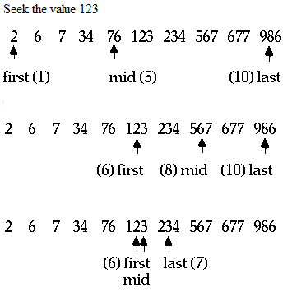
Binary Search example (Seek for 123)

Slide 50
Binary Search Program
#include<iostream.h>
#include<conio.h>
#include<stdlib.h>
#include<abstarry.h>
void main()
{
int a[20],n,beg,end,mid,f=0,element;
cout<<"\nEnter number of elements:";
cin>>n;
cout<<"\nEnter elements in sorted order:\n";
for(int i=0;i<n;i++)
cin>>a[i];
cout<<"\n You have entered:";
for(i=0;i<n;i++)
cout<<a[i]<<" ";
cout<<"\nEnter element you want to search:";
cin>>element;
beg=0;
end=n-1;
while(beg<=end)
{
mid=(beg+end)/2;
if(element<a[mid])
beg=mid-1;
else if (element>a[mid])
beg=mid+1;
else if(element==a[mid])
{
cout<<"!..................!";
cout<<"\nposition is:"<<mid;
cout<<"\n!..................!";
f=1;
break;
}
}
if(f==0)
cout<<"\nElement does not exist";
getch();
}

Slide 51
Binary Search - Complexity
O(log₂ n) . Each comparison reduces the sample size in half. Hence we require at most log₂ n comparisons to locate ITEM. For Ex, there are 100 elements, so maximum number of comparisons to find the element will be:
log₂ n = log₂ 100 => 2? =100
=> 2⁷ =100
i.e. 7(6.643856) comparisons on 100 elements
Limitations:
The list must be sorted

Slide 52
Sorting – Bubble sort
Bubble sorting is an algorithm in which we are comparing first 2 values and put the larger on at higher index.
This process do iteratively until the largest value is not reached at last index. Then start again from 0 index up to n-1 index.
Bubble sort is also known as exchange sort.
Bubble sort is the simplest sorting algorithm.

Slide 53
Bubble sort(contd..)
Sorting takes an unordered collection and makes it an ordered one.
1 2 3 4 5 6
77
42
35
12
101
5
1 2 3 4 5 6
5
12
35
42
77
101

Slide 54
"Bubbling Up" the Largest Element
Traverse a collection of elements
Move from the front to the end
“Bubble” the largest value to the end using pair-wise comparisons and swapping
1 2 3 4 5 6
77
42
35
12
101
5

Slide 55
"Bubbling Up" the Largest Element
Traverse a collection of elements
Move from the front to the end
“Bubble” the largest value to the end using pair-wise comparisons and swapping
Swap
1 2 3 4 5 6
42
77
77
42
35
12
101
5

Slide 56
"Bubbling Up" the Largest Element
Traverse a collection of elements
Move from the front to the end
“Bubble” the largest value to the end using pair-wise comparisons and swapping
1 2 3 4 5 6
Swap
35
77
42
77
35
12
101
5

Slide 57
"Bubbling Up" the Largest Element
Traverse a collection of elements
Move from the front to the end
“Bubble” the largest value to the end using pair-wise comparisons and swapping
1 2 3 4 5 6
Swap
12
77
42
35
77
12
101
5

Slide 58
"Bubbling Up" the Largest Element
Traverse a collection of elements
Move from the front to the end
“Bubble” the largest value to the end using pair-wise comparisons and swapping
1 2 3 4 5 6
42
35
12
77
101
5
No need to swap

Slide 59
"Bubbling Up" the Largest Element
Traverse a collection of elements
Move from the front to the end
“Bubble” the largest value to the end using pair-wise comparisons and swapping
1 2 3 4 5 6
Swap
5
101
42
35
12
77
101
5

Slide 60
"Bubbling Up" the Largest Element
Traverse a collection of elements
Move from the front to the end
“Bubble” the largest value to the end using pair-wise comparisons and swapping
1 2 3 4 5 6
101
42
35
12
77
5
Largest value correctly placed

Slide 61
Bubble sort(contd.)
Notice that only the largest value is correctly placed
All other values are still out of order
So we need to repeat this process
1 2 3 4 5 6
101
42
35
12
77
5
Largest value correctly placed

Slide 62
Repeat “Bubble Up” How Many Times?
If we have N elements…
And if each time we bubble an element, we place it in its correct location…
Then we repeat the “bubble up” process N – 1 times.
This guarantees we’ll correctly place all N elements.

Slide 63
Reducing the Number of Comparisons
1 2 3 4 5 6
77
42
35
12
101
5
1 2 3 4 5 6
42
35
12
77
5
101
1 2 3 4 5 6
35
12
42
5
77
101
1 2 3 4 5 6
12
35
5
42
77
101
1 2 3 4 5 6
12
5
35
42
77
101

Slide 64
“Bubbling” All the Elements
1 2 3 4 5 6
42
35
12
77
5
101
1 2 3 4 5 6
35
12
42
5
77
101
1 2 3 4 5 6
N - 1
12
35
5
42
77
101
1 2 3 4 5 6
12
5
35
42
77
101
1 2 3 4 5 6
5
12
35
42
77
101

Slide 65
Bubble sort(contd..)
Algorithm Bubble_Sort (DATA, N):
Repeat steps 2 and 3 for K = 1 to N-1.
Set PTR: =1.[Initializes pass pointer PTR]
Repeat while PTR<=N-K: [Executes pass]
If DATA[PTR]>DATA[PTR+1],then:
TEMP := DATA[PTR], DATA[PTR] := DATA[PTR+1], DATA[PTR+1] := temp
[End of if structure]
Set PTR: =PTR+1 [End of inner loop]
[End of step 1 Outer loop]
4. Exit
1 2 3 4 5 6
77
42
35
12
101
5

Slide 66
Program for Bubble sort
Program to sort an array of integers in ascending order using bubble sort.
#include<iostream.h>
#include<conio.h>
void main()
{
clrscr();
int a[5],i,j,temp;
cout<<"Enter the 5 elements: ";
for(i=0;i<5;i++)
{
cin>>a[i];
}
for(i=0;i<5;i++)
{
for(j=0;j<5-i-1;j++)
{
if(a[j]>a[j+1])
{
temp=a[j+1];
a[j+1]=a[j];
a[j]=temp;
}
}
}
cout<<"\nSorted list: ";
for(i=0;i<5;i++)
{
cout<<a[i]<<“ ";
}
getch();
}

Slide 67
Complexity of the bubble sort algorithm
The time for a sorting algorithm is measured in terms of the number of comparisons. The number f(n) of comparisons in the bubble sort is easily computed. Specifically there are n -1 comparisons during first pass, which places the largest element in the last position, there are n -2 comparisons in the second step, which places the second largest element in the last position, and so on. Thus,
f(n) = (n-1)+(n-2)+. . . +2+1 =n(n-1)/2= O(n² )
In other words, the time required to execute bubble sort algorithm is proportional to n², where n is the number of input items.
It works best for small size files & worst for large size files.
Least efficient.

Slide 68
Algorithm for Insertion sort
Algorithm Insertion_Sort (DATA, N):
Repeat steps 2 to 4 for K = 2,3…N-1:
Set TEMP:= a[K] and J=k-1
Repeat while TEMP<a[J] and J>=1
Set a[J+1]:= a[J]. [Moves element forward]
Set J:=J-1
[End of loop]
4. Set a[J+1]:=TEMP. [Inserts element in proper place]
[End of step 1 Outer loop]
5. Exit

Slide 69
Example: Insertion Sort
Pass 1: 1 comparisons
1 2 3 4 5 6 7
35
20
40
100
3
10
15
1 2 3 4 5 6 7
35
35
40
100
3
10
15
1 2 3 4 5 6 7
20
35
40
100
3
10
15
Pass 2: 2 comparisons
1 2 3 4 5 6 7
20
35
40
100
3
10
15
1 2 3 4 5 6 7
20
35
40
100
3
10
15

Slide 70
Insertion Sort(contd..)
Pass 3: 3 comparisons
1 2 3 4 5 6 7
20
35
40
100
3
10
15
20
35
40
100
3
10
15
Pass 4: 4 comparisons
1 2 3 4 5 6 7
20
35
40
100
3
10
15
20
35
40
100
100
10
15
20
35
40
40
100
10
15
20
35
35
40
100
10
15
20
20
35
40
100
10
15
3
20
35
40
100
10
15

Slide 71
Insertion Sort(contd..)
Pass 5: 5 comparisons
1 2 3 4 5 6 7
3
20
35
40
100
10
15
3
20
35
40
100
100
15
3
20
35
40
40
100
15
3
20
20
35
40
100
15
3
10
20
35
40
100
15

Slide 72
Insertion Sort(contd..)
Pass 6: 6 comparisons
1 2 3 4 5 6 7
3
10
20
35
40
100
15
3
10
20
35
40
100
100
3
10
20
35
40
40
100
3
10
20
35
35
40
100
3
10
20
20
35
40
100
3
10
15
20
35
40
100

Slide 73
Program for Insertion Sort
Program to sort an array of integers in ascending order using insertion sort.
#include<iostream.h>
#include<conio.h>
void main()
{
clrscr();
int a[5],i,j,k,temp;
cout<<"Enter the 5 elements: ";
for(i=0;i<5;i++)
{
cin>>a[i];
}
for(k=1;k<5;k++)
{
temp=a[k];
J=k-1;
while((temp<a[j]) && (j>=0))
{
a[j+1]=a[j];
j=j-1;
}
a[j+1]=temp;
}
cout<<"\nSorted list: ";
for(i=0;i<5;i++)
{
cout<<a[i]<<“ ";
}
getch();
}

Slide 74
Complexity Analysis of the Insertion sort algorithm
The worst case performance occurs when the elements of the input array are in descending order. In that case, the first pass requires 1 comparison, the 2nd pass requires 2 comparisons , and kth element requires (k-1) and finally the last pass requires (n-1) comparisons. Therefore, total no. of comparisons in case of descending order(worst case) is:
F(n)= 1+2+3….+(n-1)
=n(n-1)/2 = O(n² )
Total number of comparisons in case of ascending order (best case) is: (n-1) comparisons
i.e. f(n)=O(n) .

Slide 75
Algorithm for Selection Sort
Algorithm : (selection_sort) SELECTION(A,N)
This algorithm sorts the array A with N elements.
Repeat steps 2 & 3 for K = 1,2…N-1:
Call MIN(A,K,N,LOC)
Interchange A[K] & A[LOC].]
Set TEMP=A[K], A[K]=A[LOC] & A[LOC]=TEMP
[End of step1 loop]
Exit.
Algorithm: MIN(A,K,N,LOC)
This algorithm finds the location LOC of the smallest element among A[K], A[K+1], …+A[N]
Set MIN=A[k] & LOC=K. [Initializes pointers]
Repeat for J=K+1,K+2,..N:
If MIN>A[J], then: Set MIN=A[J] & LOC=J
[End of loop]
3. Return

Slide 76
Example: Selection Sort
1 | 2 | 3 | 4 | 5 | 6 | 7 | 8
77 | 33 | 44 | 11 | 88 | 22 | 66 | 55
k=1 | 1 | 2 | 3 | 4 | 5 | 6 | 7 | 8
 | 77 | 33 | 44 | 11 | 88 | 22 | 66 | 55 | min=77, loc=1
 | 77 | 33 | 44 | 11 | 88 | 22 | 66 | 55 | min=33, loc=2
 | 77 | 33 | 44 | 11 | 88 | 22 | 66 | 55 | min=33,loc=2
 | 77 | 33 | 44 | 11 | 88 | 22 | 66 | 55 | min=11,loc=4
 | 77 | 33 | 44 | 11 | 88 | 22 | 66 | 55 | min=11,loc=4
 | 77 | 33 | 44 | 11 | 88 | 22 | 66 | 55 | min=11,loc=4
 | 77 | 33 | 44 | 11 | 88 | 22 | 66 | 55 | min=11,loc=4
 | 77 | 33 | 44 | 11 | 88 | 22 | 66 | 55 | min=11,loc=4
 |  |  |  |  |  |  |  |  | swap(a[k],a[loc])
 | 11 | 33 | 44 | 77 | 88 | 22 | 66 | 55 | swap(a[1],a[4])

Slide 77
k=2 | 1 | 2 | 3 | 4 | 5 | 6 | 7 | 8
 | 11 | 33 | 44 | 77 | 88 | 22 | 66 | 55 | min=33,loc=2
 | 11 | 33 | 44 | 77 | 88 | 22 | 66 | 55 | min=33,loc=2
 | 11 | 33 | 44 | 77 | 88 | 22 | 66 | 55 | min=33,loc=2
 | 11 | 33 | 44 | 77 | 88 | 22 | 66 | 55 | min=33,loc=2
 | 11 | 33 | 44 | 77 | 88 | 22 | 66 | 55 | min=22,loc=6
 | 11 | 33 | 44 | 77 | 88 | 22 | 66 | 55 | min=22,loc=6
 | 11 | 33 | 44 | 77 | 88 | 22 | 66 | 55 | min=22,loc=6
 |  |  |  |  |  |  |  |  | swap(a[k],a[loc])
 | 11 | 22 | 44 | 77 | 88 | 33 | 66 | 55 | swap(a[2],a[6])
k=3 | 1 | 2 | 3 | 4 | 5 | 6 | 7 | 8
 | 11 | 22 | 44 | 77 | 88 | 33 | 66 | 55 | min=44,loc=3
 | 11 | 22 | 44 | 77 | 88 | 33 | 66 | 55 | min=44,loc=3
 | 11 | 22 | 44 | 77 | 88 | 33 | 66 | 55 | min=44,loc=3
 | 11 | 22 | 44 | 77 | 88 | 33 | 66 | 55 | min=33,loc=6
 | 11 | 22 | 44 | 77 | 88 | 33 | 66 | 55 | min=33,loc=6
 | 11 | 22 | 44 | 77 | 88 | 33 | 66 | 55 | min=33,loc=6
 |  |  |  |  |  |  |  |  | swap(a[k],a[loc])
 | 11 | 22 | 33 | 77 | 88 | 44 | 66 | 55 | swap(a[3],a[6])

Slide 78
k=4 | 1 | 2 | 3 | 4 | 5 | 6 | 7 | 8
 | 11 | 22 | 33 | 77 | 88 | 44 | 66 | 55 | min=77,loc=4
 | 11 | 22 | 33 | 77 | 88 | 44 | 66 | 55 | min=77,loc=4
 | 11 | 22 | 33 | 77 | 88 | 44 | 66 | 55 | min=44,loc=6
 | 11 | 22 | 33 | 77 | 88 | 44 | 66 | 55 | min=44,loc=6
 | 11 | 22 | 33 | 77 | 88 | 44 | 66 | 55 | min=44,loc=6
 |  |  |  |  |  |  |  |  | swap(a[k],a[loc])
 | 11 | 22 | 33 | 44 | 88 | 77 | 66 | 55 | swap(a[4],a[6])
k=5 | 1 | 2 | 3 | 4 | 5 | 6 | 7 | 8
 | 11 | 22 | 33 | 44 | 88 | 77 | 66 | 55 | min=88,loc=5
 | 11 | 22 | 33 | 44 | 88 | 77 | 66 | 55 | min=77,loc=6
 | 11 | 22 | 33 | 44 | 88 | 77 | 66 | 55 | min=66,loc=7
 | 11 | 22 | 33 | 44 | 88 | 77 | 66 | 55 | min=55,loc=8
 |  |  |  |  |  |  |  |  | swap(a[k],a[loc])
 | 11 | 22 | 33 | 44 | 55 | 77 | 66 | 88 | swap(a[5],a[8])

Slide 79
k=6 | 1 | 2 | 3 | 4 | 5 | 6 | 7 | 8
 | 11 | 22 | 33 | 44 | 55 | 77 | 66 | 88 | min=77,loc=6
 | 11 | 22 | 33 | 44 | 55 | 77 | 66 | 88 | min=66,loc=7
 | 11 | 22 | 33 | 44 | 55 | 77 | 66 | 88 | min=66,loc=7
 |  |  |  |  |  |  |  |  | swap(a[k],a[loc])
 | 11 | 22 | 33 | 44 | 55 | 66 | 77 | 88 | swap(a[6],a[7])
k=7 | 1 | 2 | 3 | 4 | 5 | 6 | 7 | 8
 | 11 | 22 | 33 | 44 | 55 | 66 | 77 | 88 | min=77,loc=7
 | 11 | 22 | 33 | 44 | 55 | 66 | 77 | 88 | min=77,loc=7
 |  |  |  |  |  |  |  |  | no swap(a[k],a[loc])
 |  |  |  |  |  |  |  |  | swap(a[7],a[7])

Slide 80
Program for Selection Sort
Program to sort an array of integers in ascending order using selection sort.
#include<iostream.h>
#include<conio.h>
void main()
{
clrscr();
int a[5],min,i,j,temp;
cout<<"Enter the 5 elements: ";
for(i=0;i<5;i++)
{
cin>>a[i];
}
for(j=0;j<5;j++)
{
min=j;
for(i=j+1;i<5;i++)
{
if(a[i]<a[min])
{
min=i;
}
}
if(min!=j)
{
temp=a[j];
a[j]=a[min];
a[min]=temp;
}
}
cout<<"\nSorted list: ";
for(i=0;i<5;i++)
{
cout<<a[i]<<" ";
}
getch();
}

Slide 81
Complexity of the Selection sort algorithm
Number of comparisons in the selection sort algorithm is independent of the original order of the elements. N-1 comparisons required during pass1 to find the smallest element, n-2 in 2nd pass and so on.
f(n) =(n-1)+(n-2)+…..2+1= n(n-1)/2 = O(n² )

Slide 82
Merging Arrays
Appending data of one array with another array is called merging arrays.
In case of merge sort, array is recursively divided into two halves, then both arrays are sorted and again sorted to make single sorted array.
Merge Sort

Slide 83
Merge Sort(contd..)
Lets take an example for merge sort. Suppose we want to sort the below values.
0 1 2 3 4 5 6
7 4 9 1 2 8 10
void mergesort(int a[],int beg, int end)
{
int mid;
if(beg<end)
{
mid=(beg+end)/2;
mergesort(a,beg,mid);
mergesort(a,mid+1,end);
mergingsortedsubarrays(a,beg,mid,mid+1,end);
}
}

Slide 84
MS(a,0,6)
Mid=3,Beg=0, End=6
MS(a,0,3)
MS(a,4,6)
MSS(a,0,3,4,6)
Mid=5,Beg=4, End=6
6
Mid=1,Beg=0, End=3
MS(a,0,1)
MS(a,2,3)
MSS(a,0,1,2,3)
MS(a,4,5)
MS(a,6,6)
MSS(a,4,5,6,6)
Mid=0,Beg=0, End=1
Mid=2,Beg=2, End=3
If(6<6)
5
3
Mid=4,Beg=4, End=5
MS(a,0,0)
MS(a,1,1)
MSS(a,0,0,1,1)
MS(a,4,4)
MS(a,5,5)
MSS(a,4,4,5,5)
1
If(4<4)
If(5<5)
If(0<0)
If(1<1)
4
MS(a,2,2)
MS(a,3,3)
MSS(a,2,2,3,3)
If(2<2)
If(3<3)
2

Slide 85
Merge Sort(contd..)
1st call: merging(a,0,0,1,1);
0 | 1 | 2 | 3 | 4 | 5 | 6
7 | 4 | 9 | 1 | 2 | 8 | 10
0 | 1 | 2 | 3 | 4 | 5 | 6
4 | 7 | 9 | 1 | 2 | 8 | 10
2nd call: merging(a,2,2,3,3);
0 | 1 | 2 | 3 | 4 | 5 | 6
4 | 7 | 9 | 1 | 2 | 8 | 10
0 | 1 | 2 | 3 | 4 | 5 | 6
4 | 7 | 1 | 9 | 2 | 8 | 10

Slide 86
Merge Sort(contd..)
3rd call: merging(a,0,1,2,3);
0 | 1 | 2 | 3 | 4 | 5 | 6
4 | 7 | 1 | 9 | 2 | 8 | 10
0 | 1 | 2 | 3 | 4 | 5 | 6
1 | 4 | 7 | 9 | 2 | 8 | 10
4th call: merging(a,4,4,5,5);
0 | 1 | 2 | 3 | 4 | 5 | 6
1 | 4 | 7 | 9 | 2 | 8 | 10
0 | 1 | 2 | 3 | 4 | 5 | 6
1 | 4 | 7 | 9 | 2 | 8 | 10

Slide 87
Merge Sort(contd..)
5th call: merging(a,4,5,6,6);
0 | 1 | 2 | 3 | 4 | 5 | 6
1 | 4 | 7 | 9 | 2 | 8 | 10
0 | 1 | 2 | 3 | 4 | 5 | 6
1 | 4 | 7 | 9 | 2 | 8 | 10
6th call: merging(a,0,3,4,6);
0 | 1 | 2 | 3 | 4 | 5 | 6
1 | 4 | 7 | 9 | 2 | 8 | 10
0 | 1 | 2 | 3 | 4 | 5 | 6
1 | 2 | 4 | 7 | 8 | 9 | 10

Slide 88
Program for Merge Sort
Program to sort an array of integers in ascending order using Merge sort.
#include<iostream.h>
#include<conio.h>
void mergesort(int a[],intbeg,int end);
void mergingsortedsubarrays(int a[7],intlb,intlr,intrb,intrr);
void main()
{
clrscr();
inti,n=7,a[7]={7,4,9,1,3,2,8};
for(i=0;i<7;i++)
cout<<a[i]<<“ “;
mergesort(a,0,n-1);
cout<<endl<<"sorted array=";
for(i=0;i<=6;i++)
cout<<a[i]<<" ";
getch();
}
void mergesort(int a[],int beg, int end)
{
int mid;
if(beg<end)
{
mid=(beg+end)/2;
mergesort(a,beg,mid);
mergesort(a,mid+1,end);
mergingsortedsubarrays(a,beg,mid,mid+1,end);
}
}

Slide 89
Program for Merge Sort(contd..)
if(na>lr)
{
while(nb<=rr)
{
c[nc]=a[nb];
nc++;
nb++;
}
}
else
{
while(na<=lr)
{
c[nc]=a[na];
nc++;
na++;
}
}
for(k=lb;k<=rr;k++)
a[k]=c[k];
}
void mergingsortedsubarrays(int a[7],int lb,int lr,int rb,int rr)
{
int na,nb,nc,k,c[7];
na=lb;
nb=rb;
nc=lb;
while((na<=lr)&&(nb<=rr))
{
if(a[na]<a[nb])
{
c[nc]=a[na];
na++;
}
else
{
c[nc]=a[nb];
nb++;
}
nc++;
}

Slide 90
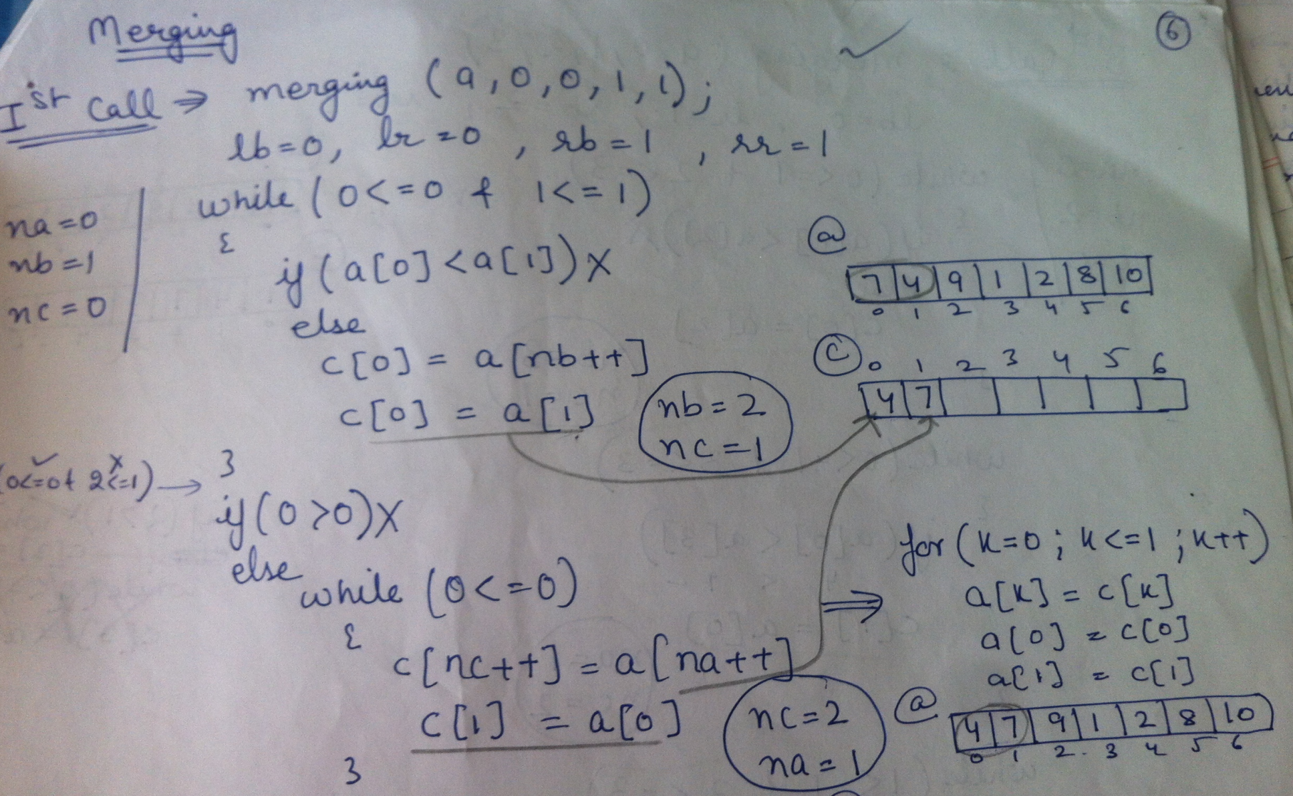
1st call: MERGINGSORTEDSUBARRAYS(a,0,0,1,1);

Slide 91
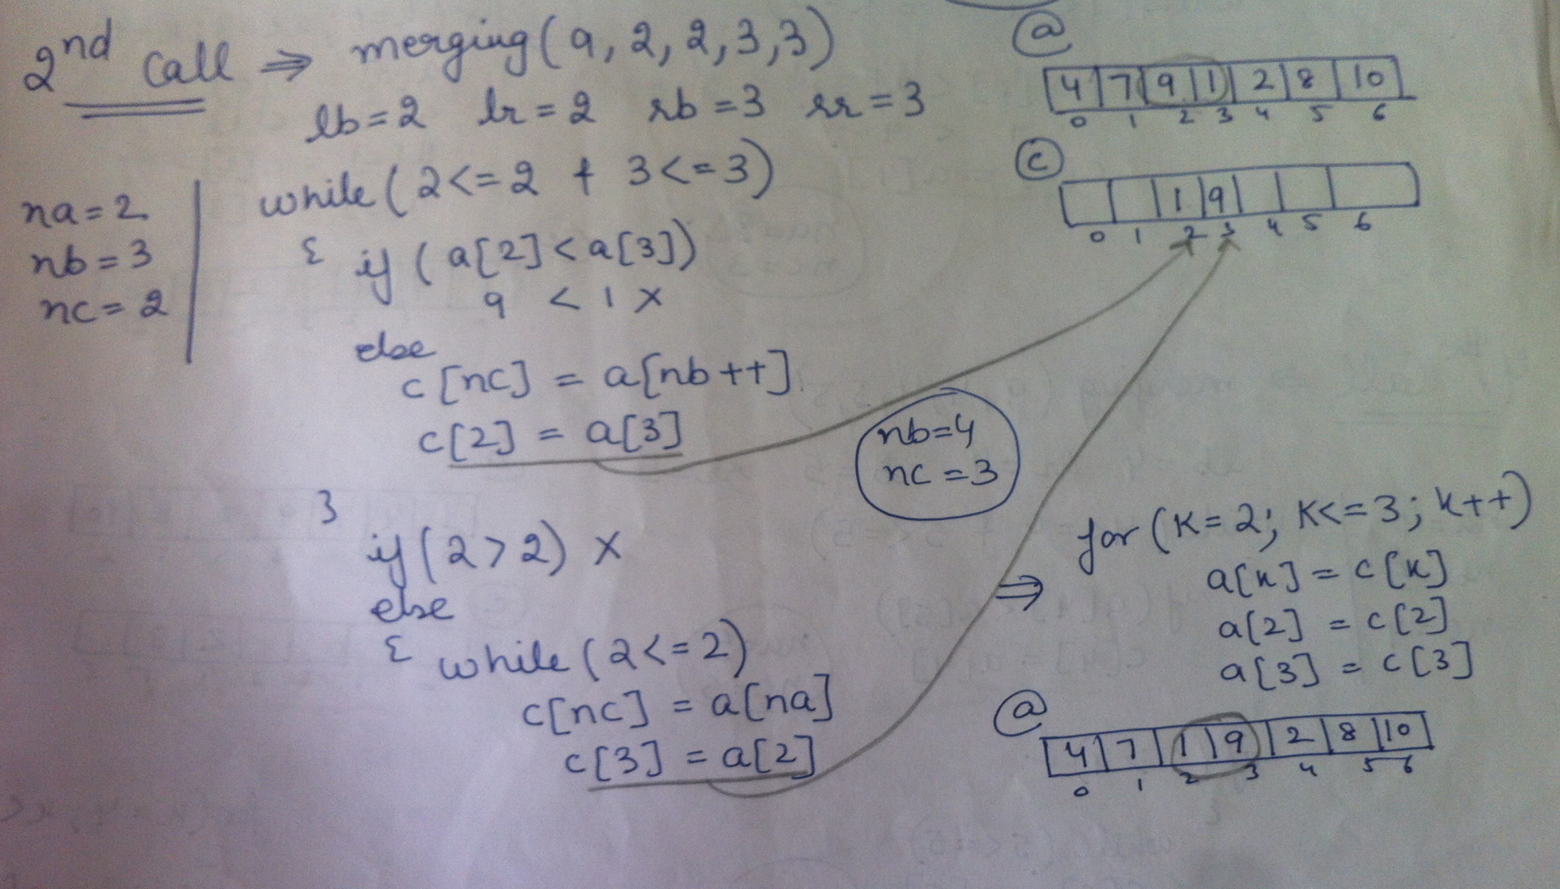
2nd call: MERGINGSORTEDSUBARRAYS(a,2,2,3,3);

Slide 92
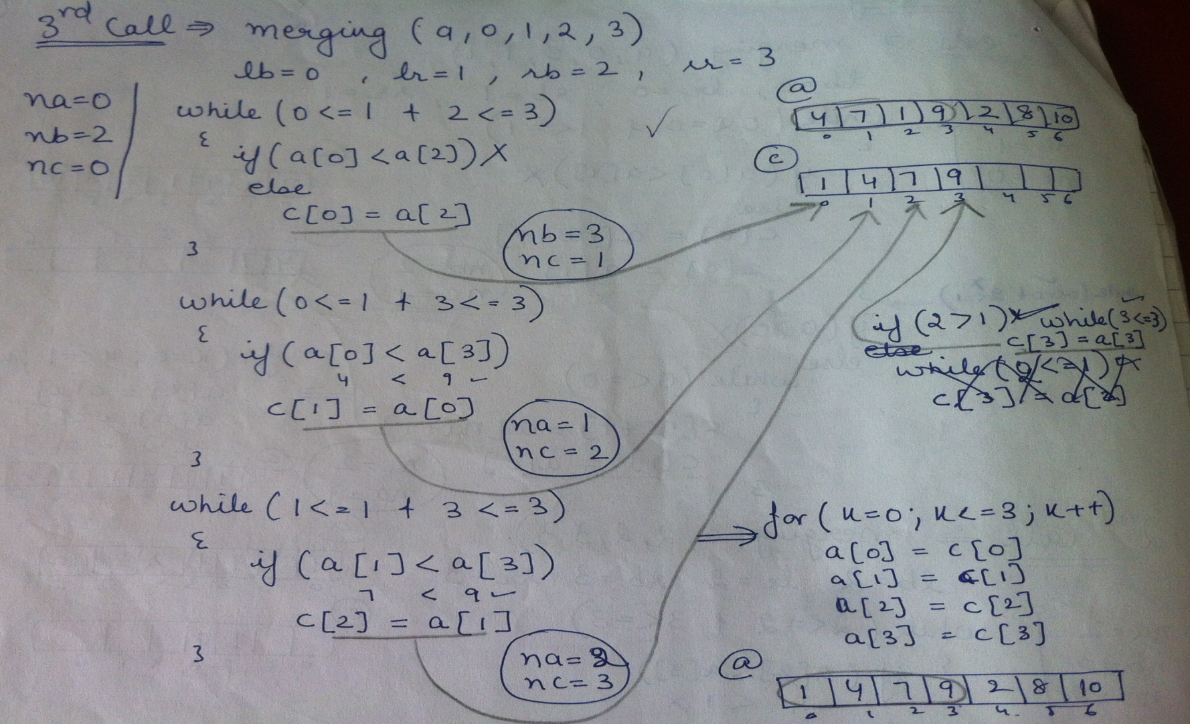
3rd call: MERGINGSORTEDSUBARRAYS(a,0,1,2,3);

Slide 93
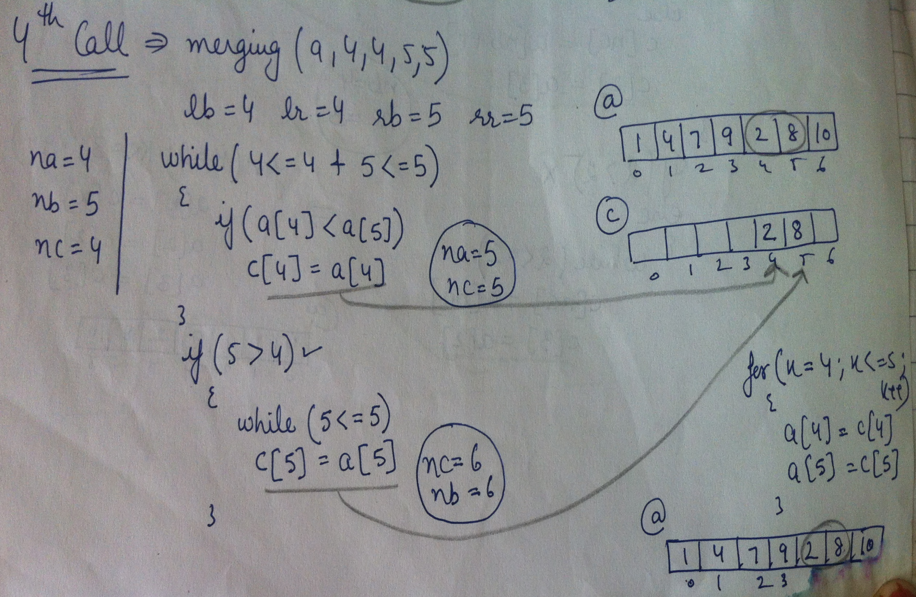
4th call: MERGINGSORTEDSUBARRAYS(a,4,4,5,5);

Slide 94
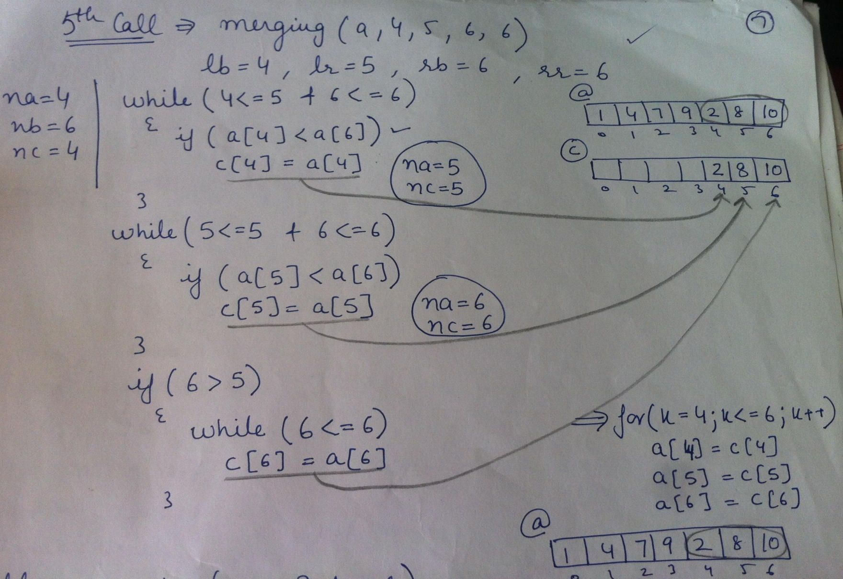
5th call: MERGINGSORTEDSUBARRAYS(a,4,5,6,6);

Slide 95
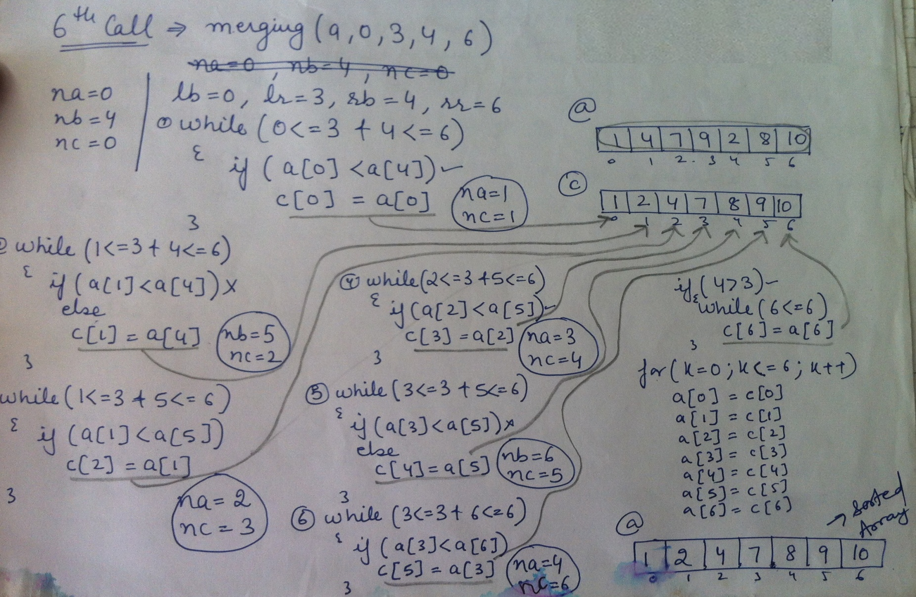
6th call: MERGINGSORTEDSUBARRAYS(a,0,3,4,6);

Slide 96
Merge sort algorithm
Mergesort(a,beg,end)
Step 1: Repeat steps 2 to 3 when mergesort is recursively called.
Step 2: Check if beg<end then:
1. Calculate mid i.e. mid=(beg+end)/2;
2. mergesort(a,beg,mid);
3. mergesort(a,mid+1,end);
4. mergingsortedsubarrays(a,beg,mid,mid+1,end);
Step3: Return

Slide 97
Mergingsortedsubarrays algorithm
Mergingsortedsubarrays(a,beg,mid,mid+1,end)
Step 1: Repeat steps 2 to 11 when mergingsortedsubarrays is called.
Step 2: Set lb=beg,lr=mid,rb=mid+1,rr=end,na=lb,nb=rb,nc=lb
Step 3: Repeat steps 4 & 5 while(na<=lr)&(nb<=rr)
Step 4: if a[na]<a[nb] then:
set c[nc]=a[na] and na=na+1
else
set c[nc]=a[nb] and nb=nb+1
Step 5: nc=nc+1
Step 6: execute step 7 if(na>lr)
Step 7: Repeat while nb<=rr
Set c[nc]=a[nb] and nc=nc+1 and nb=nb+1
Step 8: Execute step 9if (na<lr)
Step 9:Repeat while na<=lr
Set c[nc]=a[na] and nc=nc+1 and na=na+1
Step 10:Repeat for k=lb to rr
Set a[k]=c[k]
Step 11: Return

Slide 98
Complexity of the Merge sort algorithm
The major work is done by the merge procedure which has complexity of O(n). The merge procedure is called from merge sort procedure after the array is divided into 2 halves and each half has been sorted.
In each of the recursive calls, one for left half and one for right half, the array is divided into halves, thus dividing the array into 4 segments. At each level, the no. of segment doubles. Therefore, the total divisions are log n. Hence the total number of comparisons are O(n logn).
The only disadvantage of merge sort is that it uses an extra temporary array of the same size as that of input array, to merge two halves. The elements of the temporary array are copied back to the original array before next merging.

Slide 99
Multidimensional arrays
Two – dimensional Arrays
Array having more than one subscript variable is called Multi-Dimensional array.
A Two – dimensional Arrays m x n array A is a collection of m . n data elements such that each element is specified by a pair of integers (such as I, J), called subscripts.
The element of A with first subscript I and second subscript J will be denoted by A[I,J]
Columns
1 2 3
1
2
3
A[1, 1]
A[1, 2]
A[1, 3]
Rows
A[2, 1]
A[2, 2]
A[2, 3]
A[3, 1]
A[3, 2]
A[3, 3]
Fig: Two dimensional 3 x 3 array A

Slide 100
Declaration and Use of Two Dimensional Array
Declaration :
int a[3][4];
Use :
for(i=0;i<3;i++)
{
for(j=0;j<4;j++)
{
cout<<a[i][j]<<“ “;
}
cout<<“\n”;
}
Meaning of Two Dimensional Array :
1. Matrix is having 3 rows ( i takes value from 0 to 2 )
2. Matrix is having 4 Columns ( j takes
value from 0 to 3 )
3. Above Matrix 3×4 matrix will have 12 blocks having 3 rows & 4 columns.
4. Name of 2-D array is ’a’ and each block is identified by the row & column number.
5. Row number and column number starts from 0.

Slide 101
Memory Representation of 2-D array
2-D arrays are Stored in contiguous memory location row wise.
Consider 3×3 Array is stored in contiguous memory location which starts from some base address(e.g.4000) .
Array element a[1][1] will be stored at address 4000, again a[1][2]will be stored to next memory location i.e elements stored row-wise.
After Elements of First Row are stored in appropriate memory location, then second row and so on.
If we are taking integer array , then each element will require 2 bytes of memory.

Slide 102
Array Representation of 2-D array
Column-major
Row-major
Arrays may be represented in Row-major form or Column-major form.
In Row-major form, all the elements of the first row are printed, then the elements of the second row and so on up to the last row.
In Column-major form, all the elements of the first column are printed, then the elements of the second column and so on up to the last column.

Slide 103
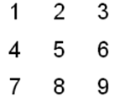
Array Representation(contd..)
Index | Memory Location | Element
a[1][1] | 4000 | 1
a[1][2] | 4002 | 2
a[1][3] | 4004 | 3
a[2][1] | 4006 | 4
a[2][2] | 4008 | 5
a[2][3] | 4010 | 6
a[3][1] | 4012 | 7
a[3][2] | 4014 | 8
a[3][3] | 4016 | 9
ARRAY
1
2
3
ROW-MAJOR
1
2
3
Index | Memory Location | Element
a[1][1] | 4000 | 1
a[2][1] | 4002 | 4
a[3][1] | 4004 | 7
a[1][2] | 4006 | 2
a[2][2] | 4008 | 5
a[3][2] | 4010 | 8
A[1][3] | 4012 | 3
a[2][3] | 4014 | 6
a[3][3] | 4016 | 9
COLUMN-MAJOR

Slide 104
Array Representation(contd..)
(Column major order )
Address(Arr[j,k])= base(Arr)+w[m(k-1)+(j-1)]
(Row major order)
Address(Arr[j,k])=base(Arr)+w[n(j-1)+(k-1)]
where m is no. of rows and n is no. of columns.
The address of Arr(2,1) & Arr(3,2)can be calculated using row-major order as:
Address(Arr(2,1))=4000+2[3(2-1)+(1-1)]
=4000+2[3*1+0]
=4000+2[3]
=4000+6
=4006
Address(Arr(3,2))=4000+2[3(3-1)+(2-1)]
=4000+2[3*2+1]
=4000+2[7]
=4000+14
=4014

Slide 105
The address of Arr(3,3) can be calculated using column-major order as:
Address(Arr(3,3))=4000+2[3(3-1)+(3-1)]
= 4000+2[3*2+2]
=4000+16
=4016
The address of Arr(2,3) can be calculated using column-major order as:
Address(Arr(2,3))=4000+2[3(3-1)+(2-1)]
= 4000+2[3*2+1]
=4000+14
=4014

Slide 106
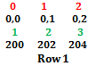
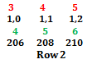
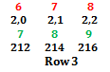
Array representation in C
0
1
2
Row- major:
0
1
2
ROW-MAJOR
Suppose a[1][2] address is to be calculated:
Calculate offset = (row×NUM_OF_COLUMNS)+column
offset = (1 ×3)+2 = 5
Address of a[1][2] = Base_address+(offset ×w)
= 200+(5 ×2) = 210
Suppose a[2][1] address is to be calculated:
Calculate offset = (row×NUM_OF_COLUMNS)+column
offset = (2 ×3)+1 = 7
Address of a[2][1] = Base_address+(offset ×w)
= 200+(7 ×2) = 214
Array | Index | Memory Location | Element
a[0][0] | 0 | 200 | 1
a[0][1] | 1 | 202 | 2
a[0][2] | 2 | 204 | 3
a[1][0] | 3 | 206 | 4
a[1][1] | 4 | 208 | 5
a[1][2] | 5 | 210 | 6
a[2][0] | 6 | 212 | 7
a[2][1] | 7 | 214 | 8
a[2][2] | 8 | 216 | 9

Slide 107
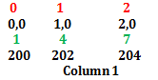
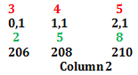
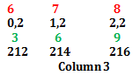
Array representation in C(contd..)
0
1
2
Column- major:
0
1
2
COLUMN-MAJOR
Suppose a[1][2] address is to be calculated:
Calculate offset = (column×NUM_OF_ROWS)+row
offset = (2 ×3)+1 = 7
Address of a[1][2] = Base_address+(offset ×w)
= 200+(7 ×2) = 214
Suppose a[0][1] address is to be calculated:
Calculate offset = (column×NUM_OF_COLUMNS)+row
offset = (1 ×3)+0 = 3
Address of a[0][1] = Base_address+(offset ×w)
= 200+(3×2) = 206
Index | Memory Location | Element
A[0][0] | 200 | 1
a[1][0] | 202 | 4
a[2][0] | 204 | 7
a[0][1] | 206 | 2
a[1][1] | 208 | 5
a[2][1] | 210 | 8
A[0][2] | 212 | 3
a[1][2] | 214 | 6
a[2][2] | 216 | 9

Slide 108
Multi- Dimensional arrays & their representation
Array with more than one dimension is known as multi dimensional array.
For Example, A is a 3-D array of 3×4×2 size. Total number of elements in an array is: 3×4×2=24.
Logically, the elements of array A are arranged in 2 layers called pages. Each page consist of 3×4 rectangular array of elements with the same 3rd subscript.
1st subscript refers to the row number.
2nd subscript refers to the column number.
3rd subscript refers to the page number.

Slide 109
Multi- Dimensional arrays representation(contd..)
 |  |  | A[1,1,2] | A[1,2,2] | A[1,3,2] | A[1,4,2]
 |  | Page 2 | A[2,1,2] | A[2,2,2] | A[2,3,2] | A[2,4,2]
 |  |  | A[3,1,2] | A[3,2,2] | A[3,3,2] | A[3,4,2]
 |  | A[1,1,1] | A[1,2,1] | A[1,3,1] | A[1,4,1]
 | Page 1 | A[2,1,1] | A[2,2,1] | A[2,3,1] | A[2,4,1]
 |  | A[3,1,1] | A[3,2,1] | A[3,3,1] | A[3,4,1]
2 | 3 | 4 | 5 | 6 | 7 | 8 | …………..
[1,1,1] | [1,1,2] | [1,2,1] | [1,2,2] | [1,3,1] | [1,3,2] | [1,4,1] |  | [3,4,1] | [3,4,2]

Slide 110
Multi- Dimensional arrays representation(contd..)
Program for implementing multi-dimensional array:
void main()
{
int a[3][4][2]={2,4,6,8,10,…};
int i,j,k;
for (i=0;i<=2;i++)
{
for(j=0;j<=3;j++)
{
for(k=0;k<=1;k++)
cout<<a[i][j][k]<<“ “;
}
}
}

Slide 111
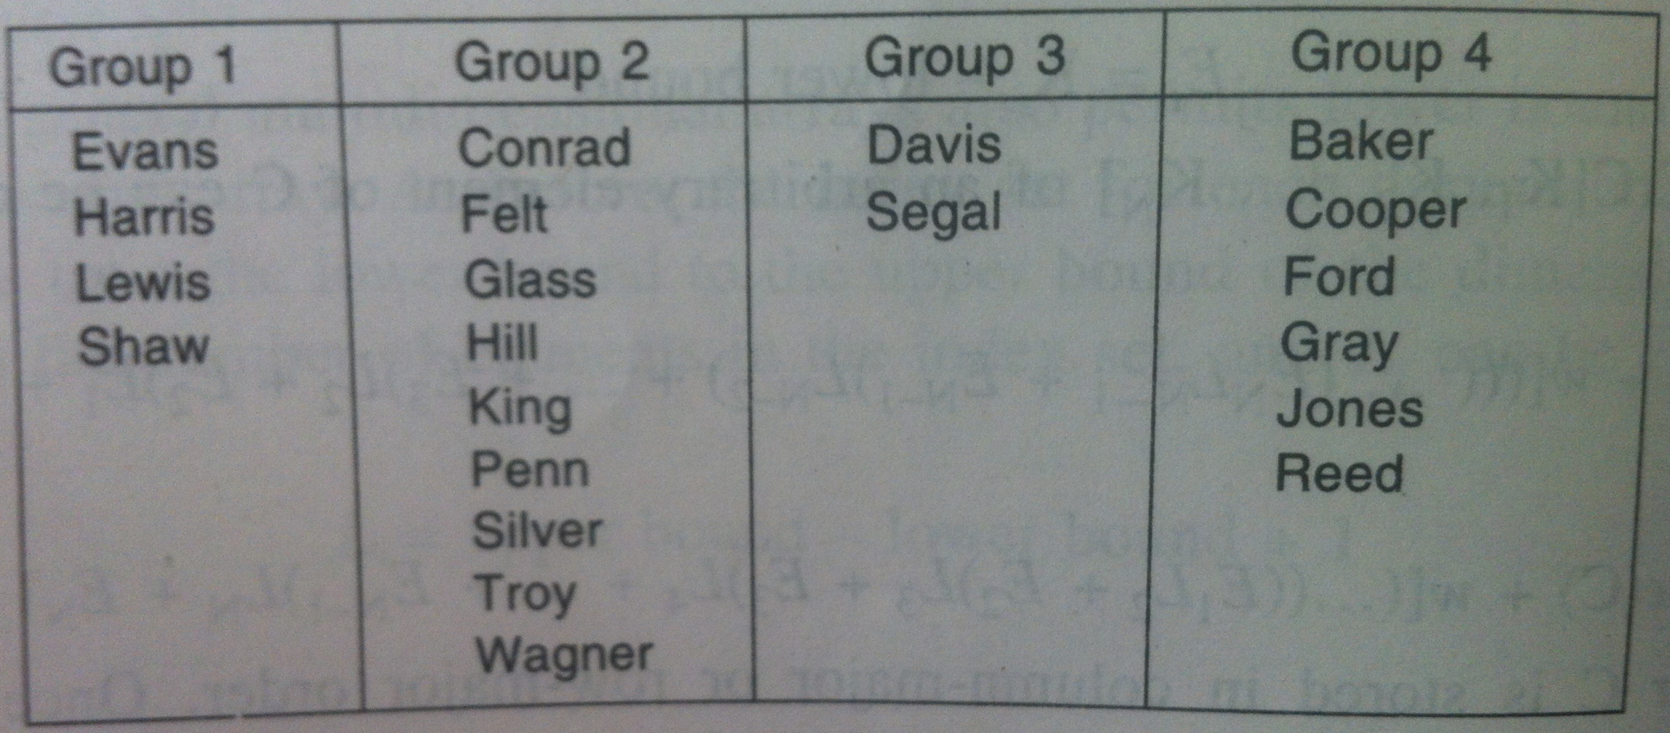
Pointers; Pointers Arrays
Consider an organization which divides its members into 4 different groups. There are 21 people & groups contain 4,9,2 & 6 people, resp.
Suppose the membership list is to be stored in memory keeping track of the different groups: 1st way to do this is to use a 2-D array where each row or column contains a group.
1st way Advantage:
This data structure allow us to access each individual group.
1st way Disadvantage: Space will be wasted when the groups vary greatly in size. For Ex, above example will require at least 36 element(9×4 array) to store 21 names.

Slide 112
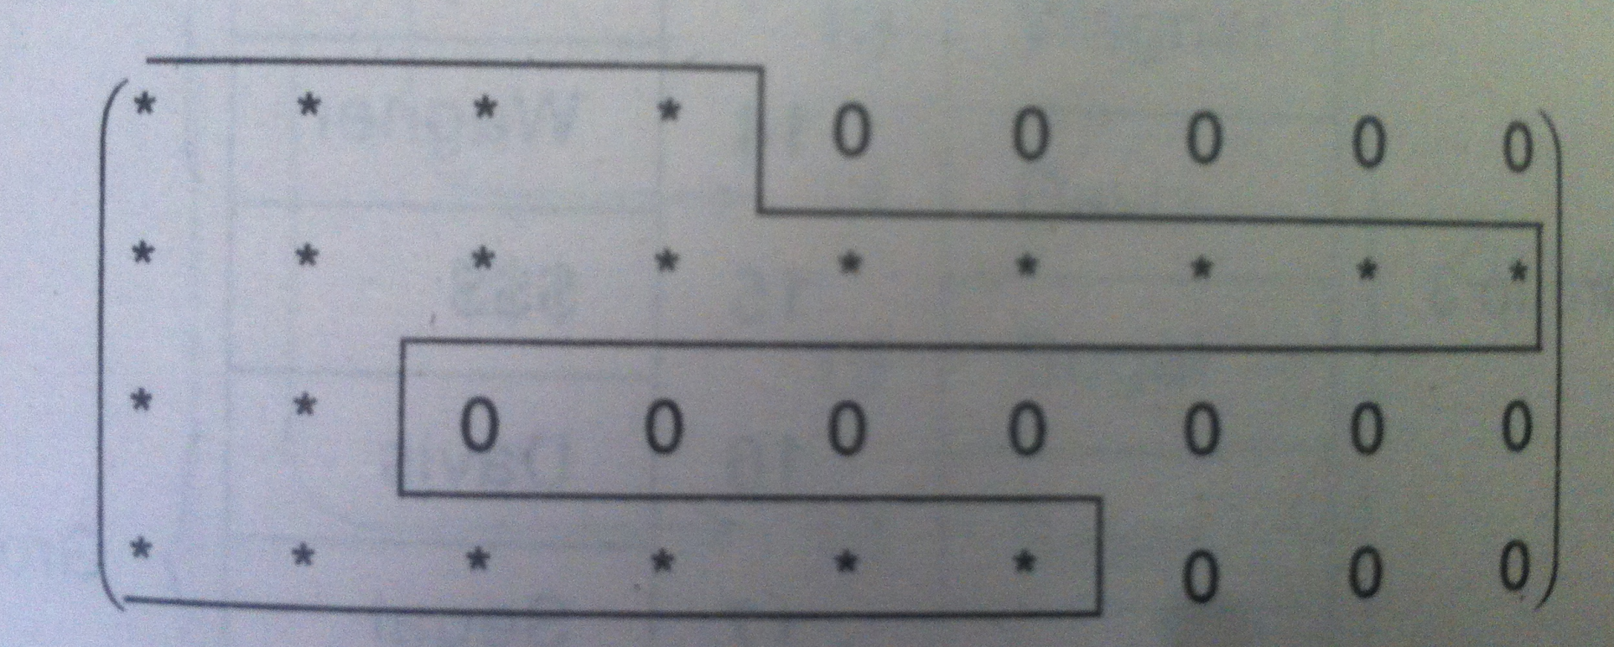
Pointers; Pointers Arrays(contd..)
Jagged Array: Array whose rows and columns begin with different number of data elements & end with unused storage locations are said to be jagged.

Slide 113
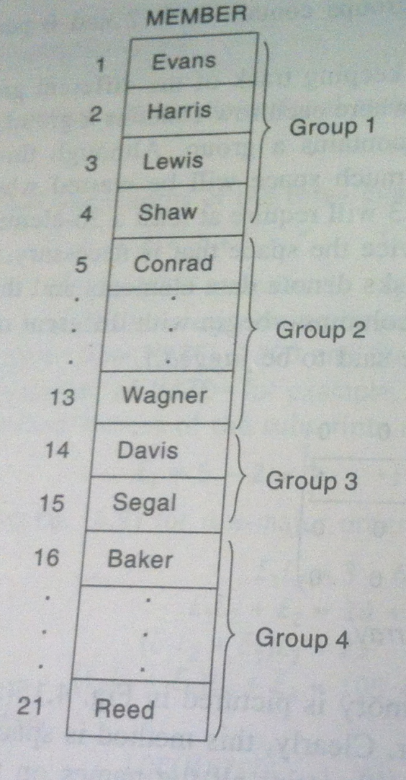
Pointers; Pointers Arrays(contd..)
2nd way the membership list can be stored in memory is shown below:
This shows list is placed in a linear array, one group after another.
2nd way Advantage:
space efficient.
Entire list can easily be processed - one can easily print all the names on the list.
2nd way Disadvantage: There is no way to access any particular group. For Ex, there is no way to find & print only the names in the third group.

Slide 114
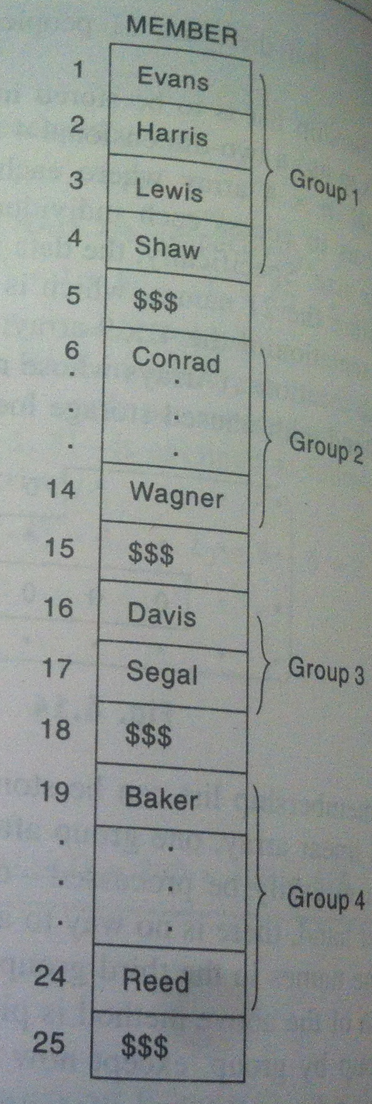
Pointers; Pointers Arrays(contd..)
In 3rd way names are listed in a linear array, group by group, except now some marker such as 3 dollar signs used here will indicate the end of a group.
3rd way Advantage:
It uses only a few extra memory cells- one for each group but now one can access any particular group.
A programmer can now find & print those names in the 3rd group by locating those names which appear after the second marker & before the 3rd marker.
3rd way Disadvantage: List still must be traversed from the beginning in order to recognize the third group. In other words, the different groups are not indexed with this representation.

Slide 115
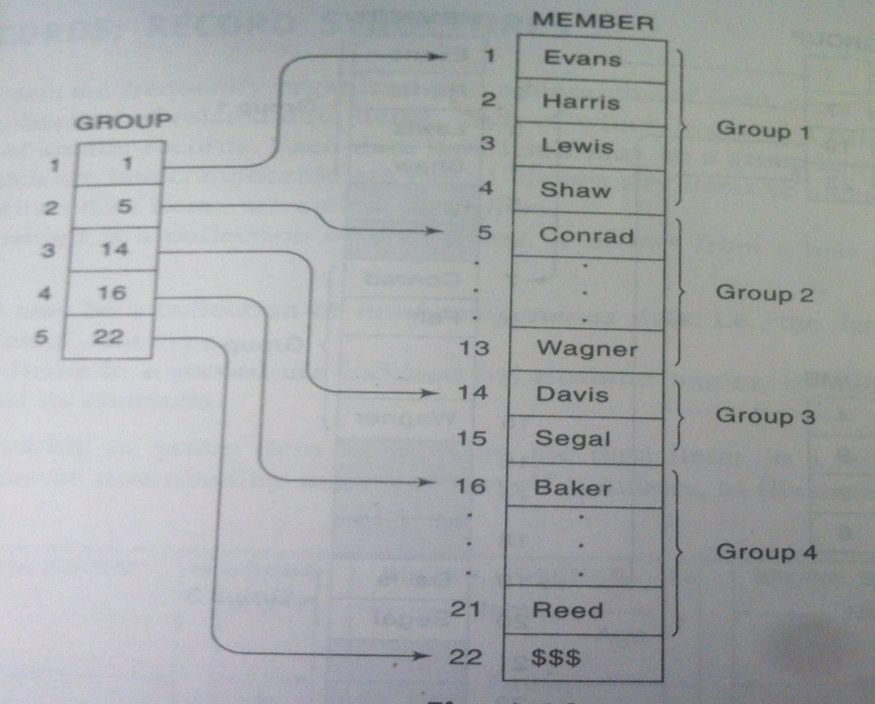
Pointer Array
The above 2 space efficient
data structures can be
easily modified so that the
individual groups can be
indexed. This is
accomplished by
pointer array.

Slide 116
Pointers in C
Pointers are variables that hold a memory location.
Consider the declaration:
int i=3;
This declaration tells the compiler to:
Reserve space in memory to hold the integer value.
Associate the name i with this memory location.
Store the value 3 at this location.
i
j
void main()
{
int i=3, *j;
j=&i;
cout<<&i; 6485
cout<<j; 6485
cout<<&j; 3276
cout<<j; 6485
cout<<i; 3
cout<<*(&i); 3
cout<<*j; 3
}
Output:
3
6485
6485
3276

Slide 117
Arithmetic on pointers
Consider the following example:
void main()
{
int i=3,*x;
float j=1.5,*y;
char k=‘c’,*z;
cout<<i<<“\t”<<j<<“\t”<<k<<“\t”; 3 1.5 c
x=&i;
y=&j;
z=&k;
cout<<x<<“\t”<<y<<“\t”<<z<<“\t”; 1002 2004 5006
x++;
y++;
z++;
cout<<x<<“\t”<<y<<“\t”<<z; 1004 2008 5007
}

Slide 118
Arithmetic on pointers(contd..)
i
j
k
3
1.5
c
1002
2004
5006
x
y
z
1002
2004
5006
4010
4024
4056

Slide 119
Arithmetic on pointers(contd..)
Following operations that can be performed on a pointer:
Addition of a number to a pointer.
Subtraction of a number from a pointer.
Following operations that cannot be performed on a pointer:
Addition of 2 pointers.
Multiplying a pointer with a number.
Dividing a pointer with a number.

Slide 120
Pointer Arrays
There are 2 ways in which we can access the elements of the array –
Using subscript notation
Using pointers
24 | 34 | 12 | 44 | 56 | 17
4001 | 4003 | 4005 | 4007 | 4009 | 4011
Using subscript notation
Using pointers
void main()
{
int num[6]={24,34,12,44,56,17};
int i=0;
while(i<=5)
{
cout<<“Address=”<<&num[i]<<“ \t“;
cout<<“element is=”<<num[i];
i++;
}
}
void main()
{
int num[6]={24,34,12,44,56,17};
int i=0;*j;
j=&num[0];
while(i<=5)
{
cout<<“Address=”<<j<<“ \t“;
cout<<“element is=”<<*j;
i++;
j++;
}
}

Slide 121
Array of pointers
arr
10 | 20 | 30 | 40
200 | 202 | 204 | 206
ptr
200 | 202 | 204 | 206
400 | 402 | 404 | 406
void main()
{
int *ptr[4];
int arr[4]={10,20,30,40};
for(i=0;i<=3;i++)
ptr[i]=&arr[i];
for(i=0;i<=3;i++)
cout<<*ptr[i]<<“\t”;
}
OUTPUT
10 20 30 40

Slide 122
Records; Record structure, representation of records in Memory
Record: A record is a collection of related data items, each of which is called a field or attribute. Although a record is a collection of data items, it differs from a linear array in the following ways:
A record may be a collection of non-homogeneous data, i.e. the data items in a record may have different data types.
The data items in a record are indexed by attribute name. For ex, Structure in C.

Slide 123
Records or Structure in C
For example: You want to store the information about person about his/her name, citizenship number and salary. You can create these information separately but, better approach will be collection of these information under single name because all these information are related to person.
struct structure_name
{
data_type member1;
data_type member2;
.. data_type member;
}

Slide 124
Records or Structure in C(contd..)
We can create the structure for a person as mentioned above as:
struct person
{
char name[50];
int cit_no;
float salary;
};
This declaration above creates the derived data type struct person.

Slide 125
Records or Structure in C(contd..)
Structure variable declaration:
struct person
{
char name[50];
int cit_no;
float salary;
};
struct person var1, var2;
var1 |  |  |  | var2
name | cit_no | salary |  | name | cit_no | salary
50 | 2 | 4 |  | 50 | 2 | 4
56 bytes |  |  |  | 56 bytes

Slide 126
Records or Structure in C(contd..)
Accessing members of structure: Taking values from user:
cin>>var1.name;
cin>>var1.cit_no;
cin>>var1.salary;
Printing values:
cout<<var1.name;
cout<<var1.cit_no;
cout<<var1.salary;
Similarly for var2.

Slide 127
Parallel Arrays
Since records may contain non-homogeneous data, the elements of a record cannot be stored in an array. Some programming languages do have record structures built into the language.
Suppose a programming language does not have structures, then the record may have to be stored in individual variables, one for each of its data item.
On the other hand, suppose one wants to store an entire file of records. Note that all the data elements belonging to the same identifier do have the same type. Such a file may be stored in memory as a collection of parallel arrays; i.e. where elements in the different arrays with the same subscript belong to the same record.s

Slide 128
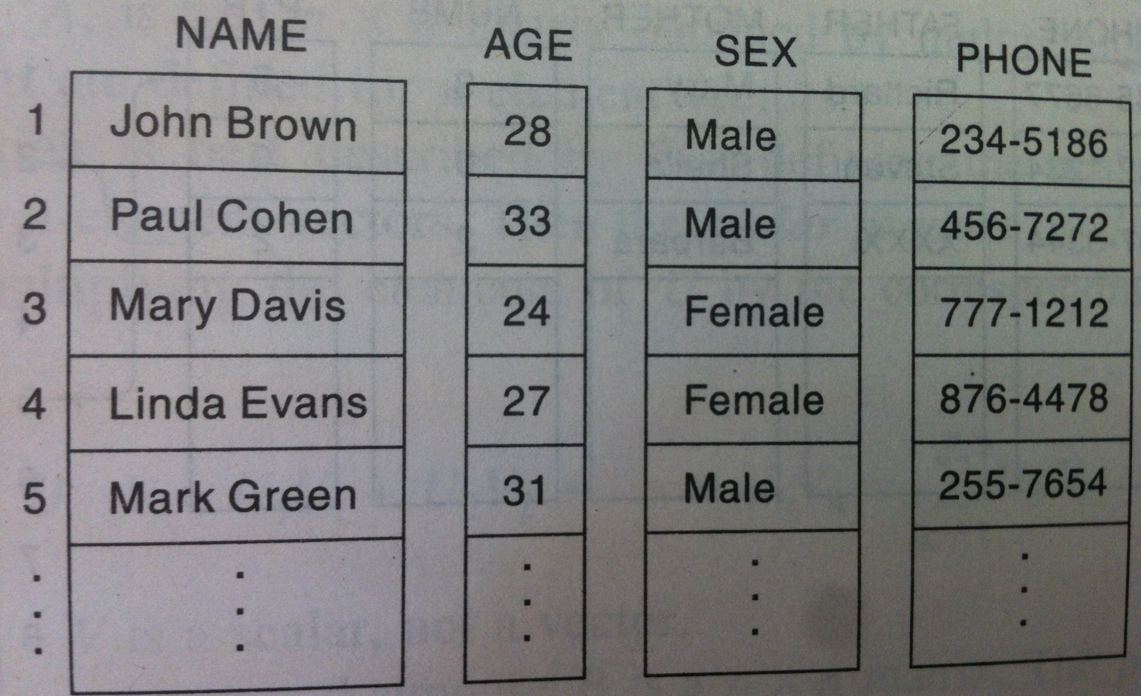
Parallel Arrays(contd..)

Slide 129
Sparse matrices
Matrices with a relatively high proportion of zero entries are called sparse matrices.
The 1st matrix where all entries above or below the main diagonal are zero are called triangular matrix.
The 2nd matrix where non-zero entries can only occur on the diagonal or on elements immediately above or below the diagonal is called a tri-diagonal matrix.

Slide 130
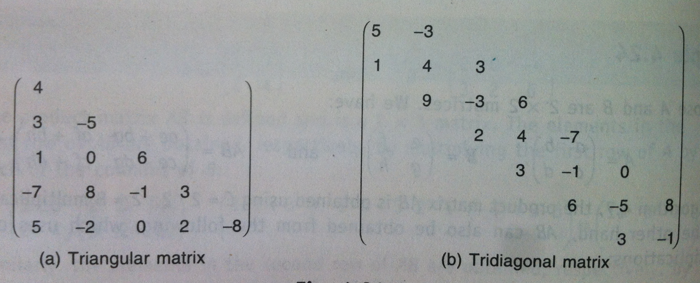
Sparse matrices(contd..)
The method of representing matrices in memory as 2-D array
may not be suitable for sparse matrices. One may save space
by storing only those entries which may be non-zero.

Slide 131
Representation of sparse matrix in memory
Scan the non-zero elements of the sparse matrix in row-major order:
Each non-zero element is represented by a triple:
(row, column, value)
List of triples may be an array list or a linked list(chain).
 | Example: Sparse Matrix,a[][]
 | 1 | 2 | 3 | 4 | 5
1 | 0 | 0 | 3 | 0 | 4
2 | 0 | 0 | 5 | 7 | 0
3 | 0 | 0 | 0 | 0 | 0
4 | 0 | 2 | 6 | 0 | 0
ARRAY REPRESENTATION
 | 0 | 1 | 2 | 3 | 4 | 5
Row | 1 | 1 | 2 | 2 | 4 | 4
Col | 3 | 5 | 3 | 4 | 2 | 3
Value | 3 | 4 | 5 | 7 | 2 | 6

Slide 132
Representation of sparse matrix in memory(contd..)
LINKED REPRESENTATION: In linked representation, node structure is:
row | col | value | next
Array of row chains:
1 |  |  | 3 | 3 |  |  | 5 | 4 | NULL
2 |  |  | 3 | 5 |  |  | 4 | 7 | NULL
3 | NULL
4 |  |  | 2 | 2 |  |  | 3 | 6 | NULL

